Slide 1
What Gets Counted, Counts Part 2
Evan Moore

Slide 2
Introduction
Title: “The Influence of Active Video Game play upon physical activity and screen-based activities in sedentary children”
Source: USDA
Theme: The goal of the dataset is to find a relationship between sedentary video gaming and a child’s drive to engage in physical activity, as well as examine whether engagement with Active Video Games (AVGs) translates to an increase in motivation for traditional physical activity.

Slide 3
Why we chose this dataset
The dataset captured our curiosity for a few reasons.
  Our own interest in video games.
  Our interest in the potential behavioral impacts and changes associated with playing video games.
  Our interest in learning about the implications of video games and sedentary activities on a behavioral level.

Slide 4
Purpose of the Dataset
The dataset was published by the Agricultural Research Service and was intended to find effective ways to encourage children to increase their level of physical activity and prevent the development of sedentary lifestyles.
Children born between 2004 and 2008, their activity statistics, questionnaire answers, 24-hour recall and accelerometer data are represented within the dataset.
The likely intended audience is parents, teachers, and anyone in a position to encourage engagement in physical activity in children.

Slide 5
Data Analysis
AVGs provided a temporary boost in physical activity.
Enjoyment of AVGs did not influence the psychology of sedentary children.
Enjoyment of AVGs did not translate to enjoyment of traditional physical activity.
Children tended to overcompensate for energy spent on PA or AVGs with increased sedentary behavior.
Missing data includes device calibrations, specific questionnaire questions, AVG titles and environmental context such as access to green spaces or neighborhood safety scores.

Slide 6
Data Production and Collection Method
Accelerometer Data: using an ActiGraph to track physical and sedentary activities at baseline, 6-weeks and 10-weeks.
24-hour Recall Data: tracking previous day’s activities at baseline, 2, 4, 6, and 10-weeks.
Liking Data: collected on a 1-10 scale for how much a participant would want to perform both physical and sedentary activities at baseline, 6-weeks and 10-weeks.
Demographics: Including weight, height, gender, race, ethnicity and year of birth.
Questionnaires: Children’s Self-Perceptions of Adequacy in Predilection of Physcial Activity Scale (CSAPPA), motivation for activity using the Behavioral Regulations in Exercise Questionnaire 2nd edition (BREQ-2), motivation for active video games using modified questions from BREQ-2, motivation for sedentary video games using modified questions from BREQ-2, and physical activity-related parenting behaviors using The Activity Support Scale for Multiple Groups (ACTS-MG)

Slide 7
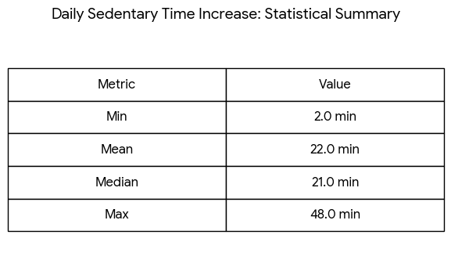
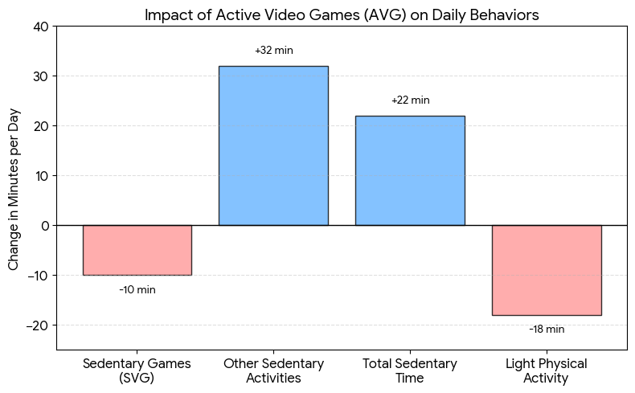
Daily Sedentary Increase and Impact of AVGs
The statistical summary shows a general increase in sedentary time across the study.
The Chart shows a decrease in Light Physical Activity.
Though Sedentary Games decreased by 10 minutes, Other Sedentary activity increased by 32 minutes.
Based on the chart, AVGs caused an increase in Sedentary Activities overall.

Slide 8
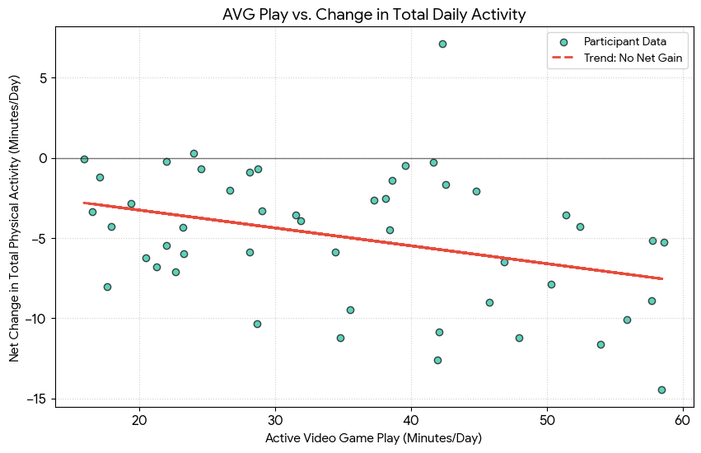
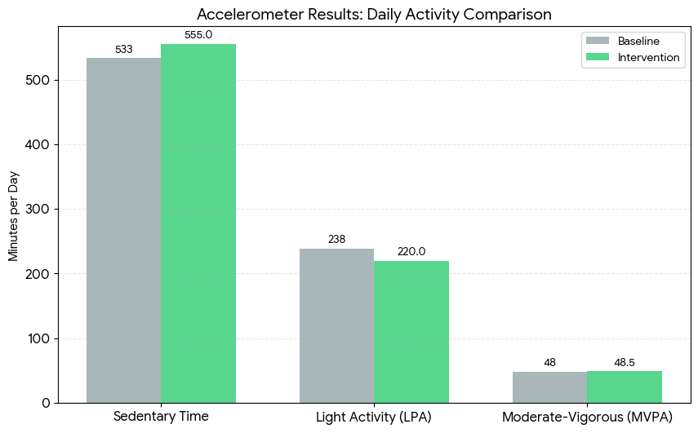
Decrease in Physical Activity
The regression line shows a net decrease in Total Physical Activity when compared against time spent playing AGVs
Based on the Chart
  Sedentary time increased post intervention.
  Light Activity decreased post intervention
  MVPA displayed only a minor increase

Slide 9
Limitations
The study only took place within a short time frame, from 2016-2018 and only children born between 2004 and 2008 participated in the study.
Small sample size of only 49 participants.
The intervention only took place across a 10-week period.
No inclusion of children that do not play sedentary video games, only targeted children already deemed as sedentary and thus lacked a real control group.
Some data relies on children’s recall memory.

Slide 10
Additional Elements for Improvement
Increasing the sample size would allow for a much more widely applicable dataset.
Wider age range to include children with potentially different relationships with technology.
Tracking sleep time can explain daily changes in physical or sedentary behavior.
Including programs or steps to log real time activity data would eliminate the reliance on children’s recall memory.

Slide 11
Power Dynamics and What Gets Counted
Places the burden of health almost entirely on individual choice and willpower.
Primarily serves Government and Policy makers.
Adult authority of the researchers.
“Sedentary Time” is inherently coded as negative.
The nature of the study can influence and encourage bias in children’s questionnaire answers
Objective, micro-level physical and psychological data is counted.
  High legibility in scientific and medical communities.
Macro-level structural and qualitative factors are ignored.
  Household income, neighborhood walkability, proximity to green spaces.
  Can be difficult or expensive to measure.
  Likely falls outside the scope of a 10-week intervention.
Erasure of Systemic inequality.
  Blame is placed primarily upon the child.
From the Policy Maker’s Perspective.
  Behavioral substitution is ineffective.
  Never get prompted to invest in structural solutions such as parks or neighborhood safety.

Slide 12
Conclusion
Through our analysis of the dataset, we were able to conclude that providing children with Active Video Games did not translate to an increase in traditional physical activities. Rather, the introduction seemed to cause a general decrease in physical activity and an increase in sedentary activity.

Slide 13
References
Ufholz, Kelsey (2021). Data from: The influence of active video game play upon physical and screen-based activities in sedentary children. Ag Data Commons. https://doi.org/10.15482/USDA.ADC/1522952

